Slide 1



TUTAMEN
Introduction To Plastic Molding

Slide 2
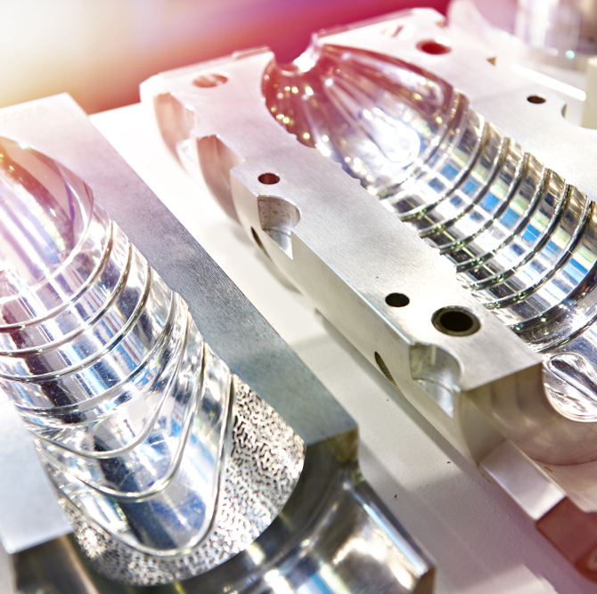

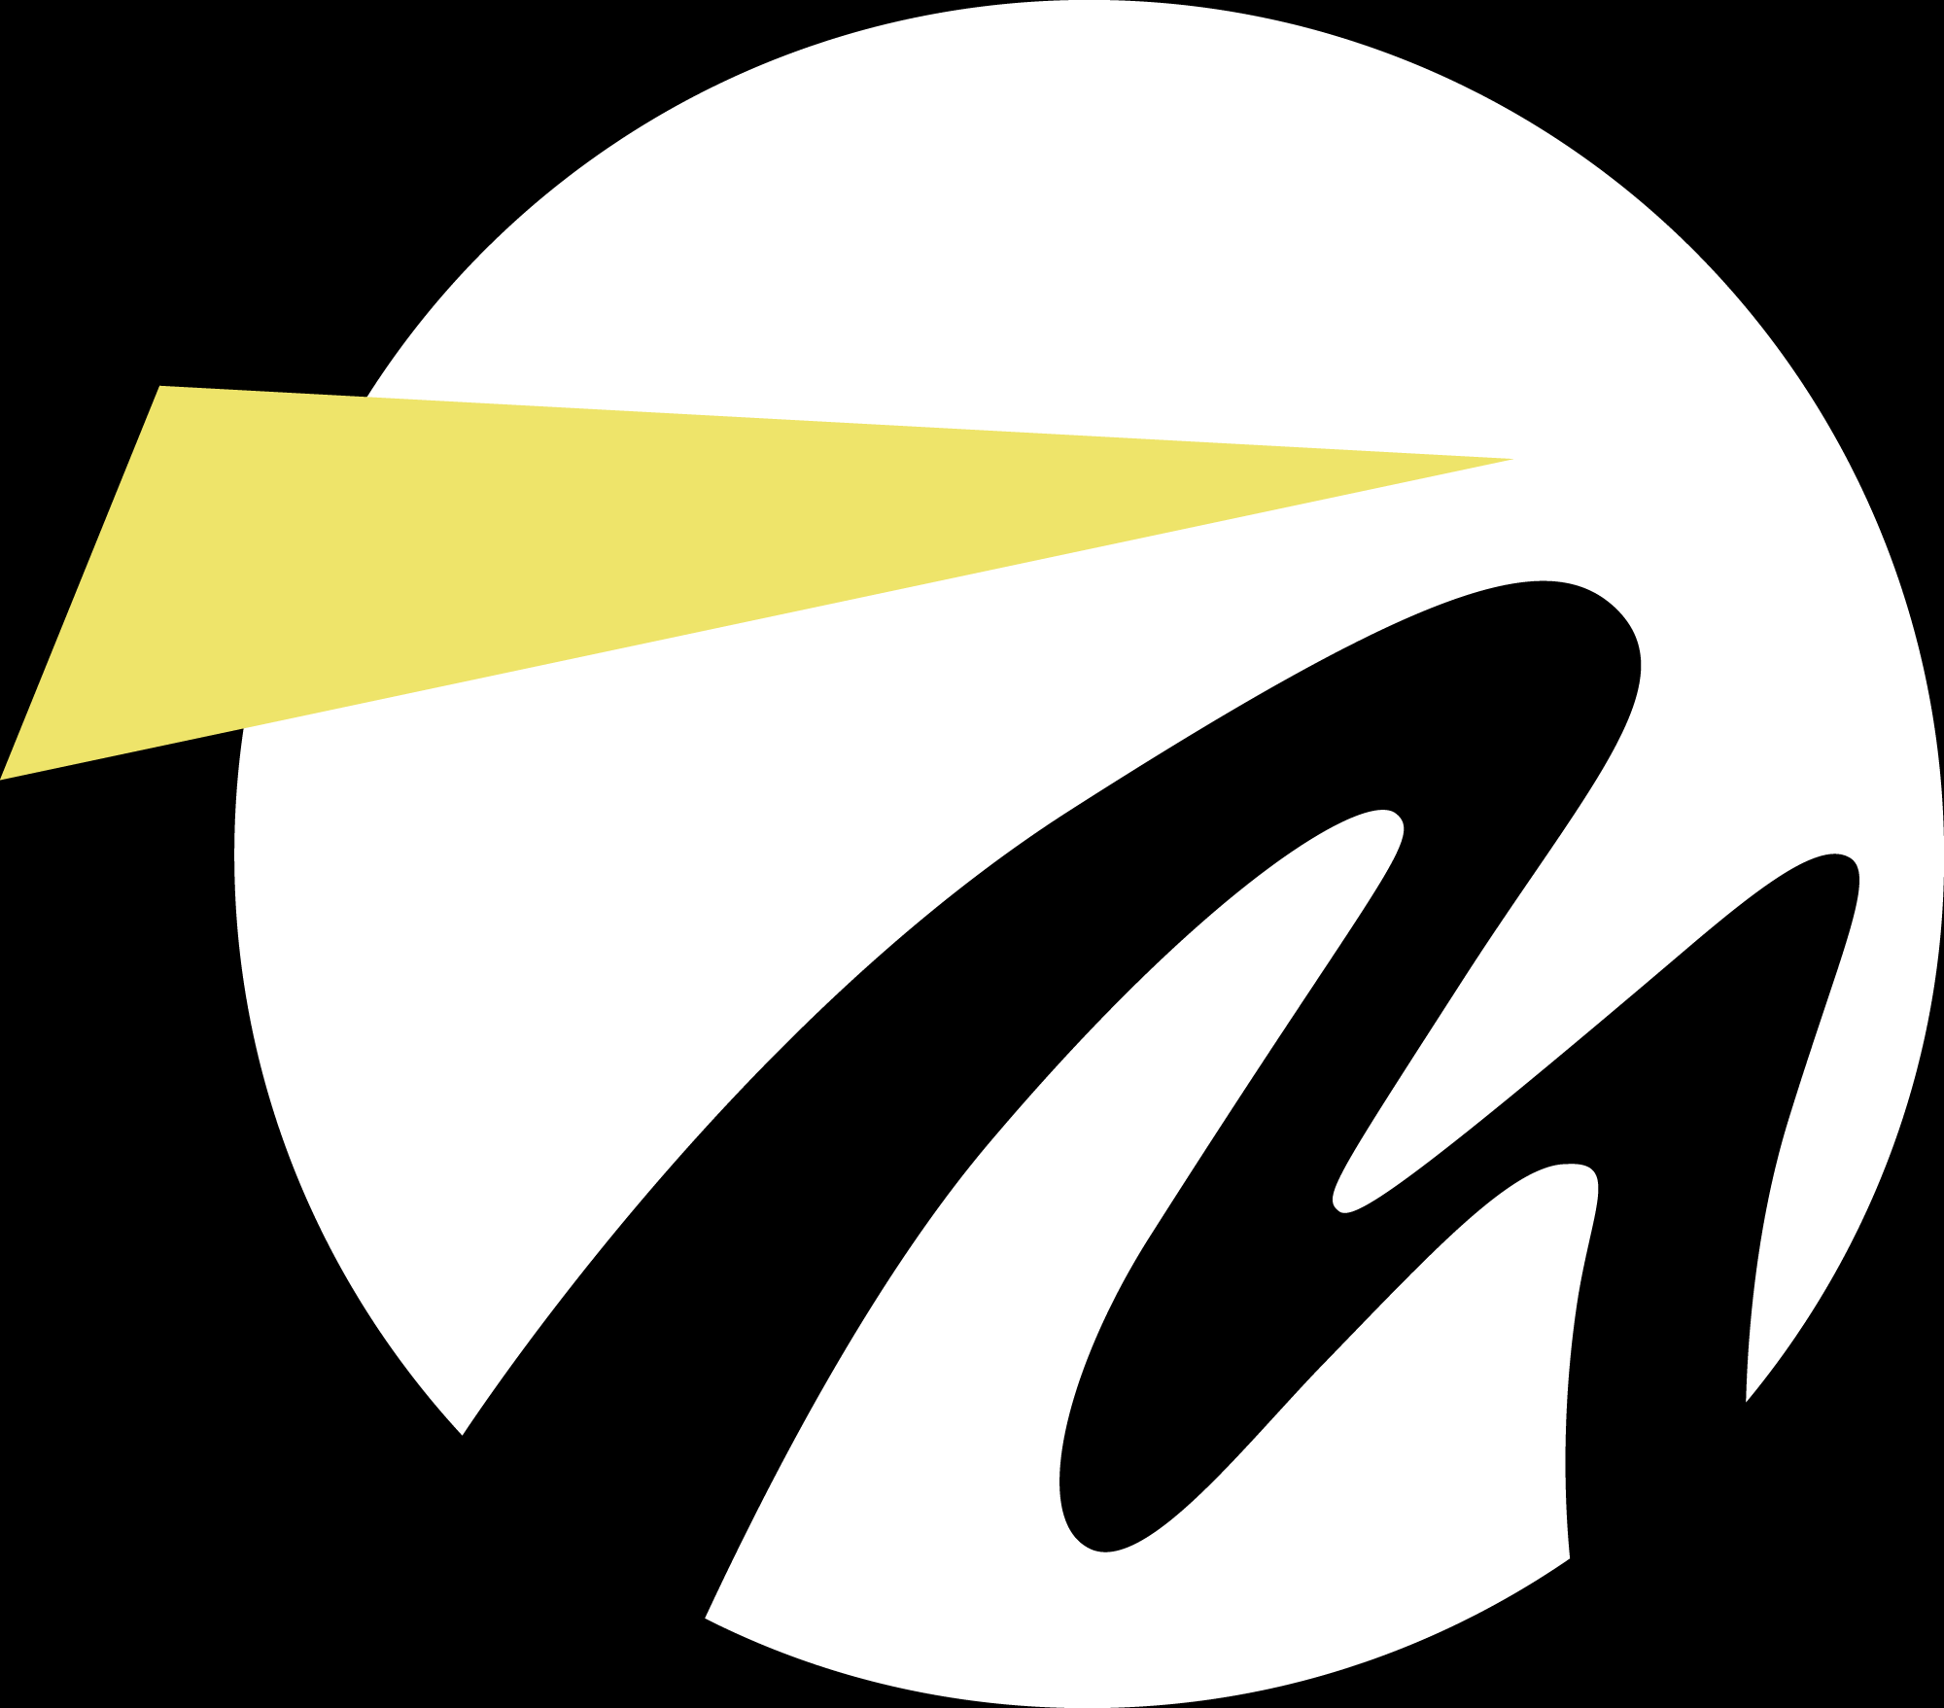
Intro To Plastic Injection Molding
Is a manufacturing technique for making parts from thermoplastic and thermoset materials
In contrast to the extrusion (which makes continuous parts of constant cross section), injection molding make discrete parts (with complex and variable cross section)
Molten plastic is injected at high pressure into a mold, which is the inverse of the desired shape
The mold is made from metal, usually either steel or aluminum
Widely used for manufacturing a variety of parts, from the smallest component to entire body panels of cars
TUTAMEN 2021 Introduction To Plastic Molding

Slide 3
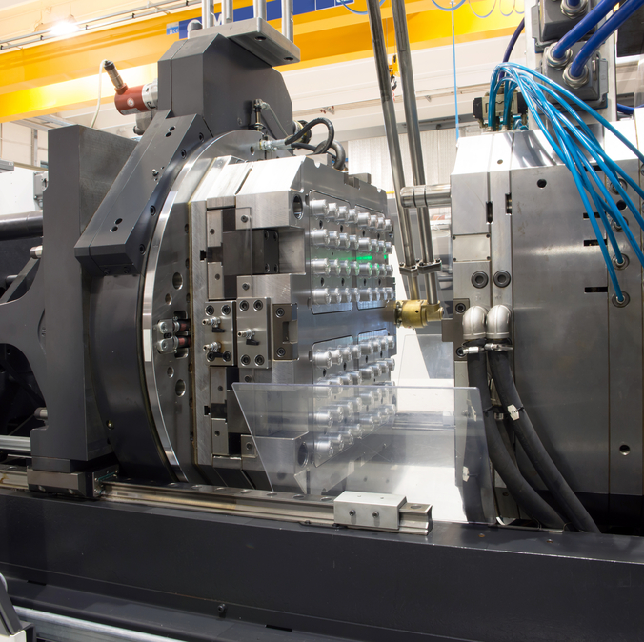
Intro To Plastic Injection Molding
The keys to success in injection molding are to have:
  Proper machines for good melting and injecting of the resin
  The proper resin to appropriate part performance
  A good mold for part definition and removal
  Proper operation for efficient molding cycle (mold cycle depends on the design of the mold and manufacturing parameters)
TUTAMEN 2021 Introduction To Plastic Molding

Slide 4
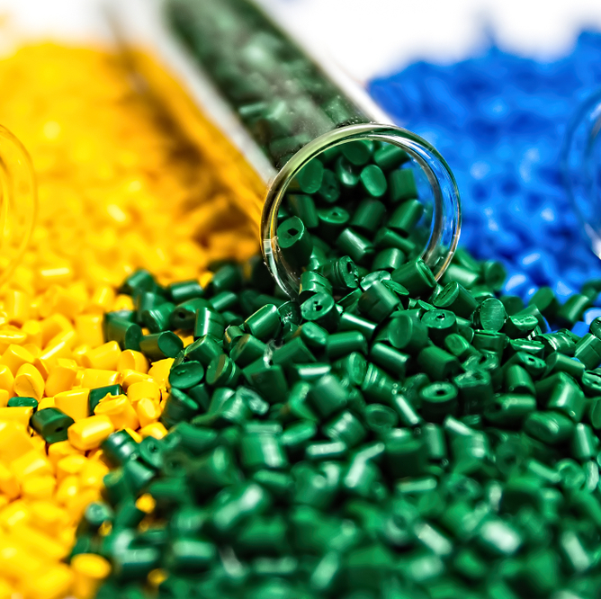
Most Common Thermoplastics and Their Uses:
Acrylonitrile-Butadiene-Styrene ABS
is among the most popular and versatile of the resins in the styrene family (which includes polystyrene). Its availability, strength, and limited shrinkage all help make it widely used as the default choice for most plastic products.
Nylon PA
is very strong, but more expensive. Being resistant to wear, nylon is used for mechanical parts such as bearings and other low- to medium-stress components.
TUTAMEN 2021 Introduction To Plastic Molding

Slide 5
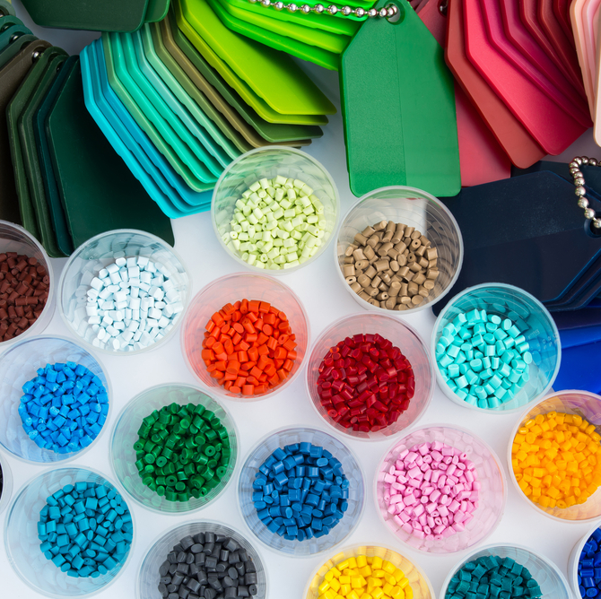
Polycarbonate PC
is stronger and more rigid than Nylon. Polycarbonate is particularly useful in clear applications such as lenses and light covers. Some forms are used for single use food containers and water bottles, but the material is not considered food-safe for reused or washed containers.
Polypropylene PP
is strong and bendable. Polypropylene is a thermoplastic that, while not as clear or cheap as polycarbonate, is safe for reusable containers and laboratory tools. It has particular resistance to fatigue which makes it ideal for living hinge applications.
Polystyrene GPPS
General Purpose, aka crystal) polystyrene is a polymer obtained from the styrene monomer: clear, rigid, and non-toxic. GPPS offers excellent dimensional quality, easy processing and coloring GPPS is developed in different grades, one for each specific necessity.
TUTAMEN 2021 Introduction To Plastic Molding

Slide 6
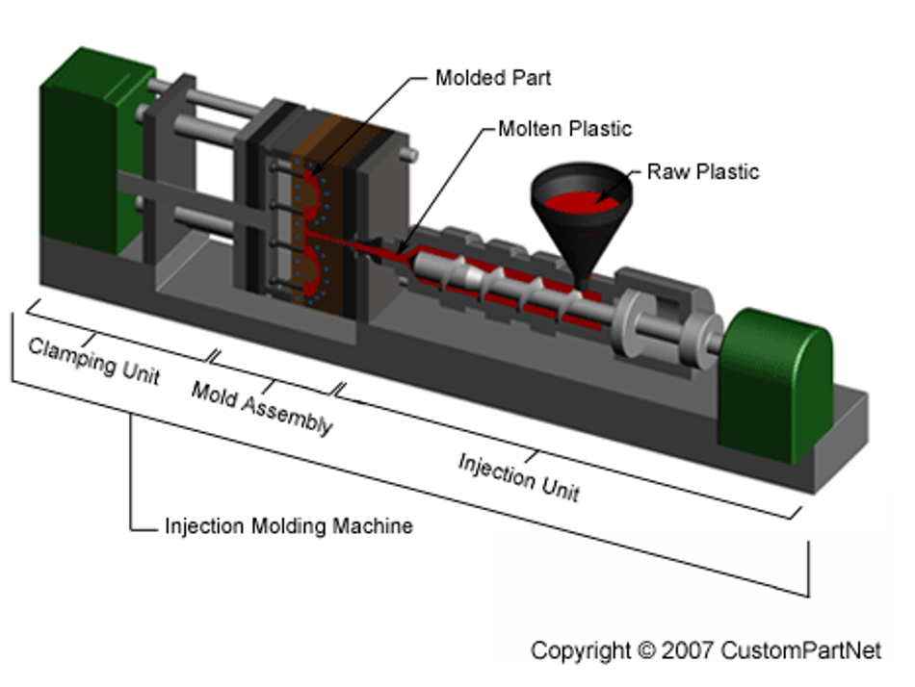

Injection Molding Machine Breakdown
TUTAMEN 2021 Introduction To Plastic Molding

Slide 7
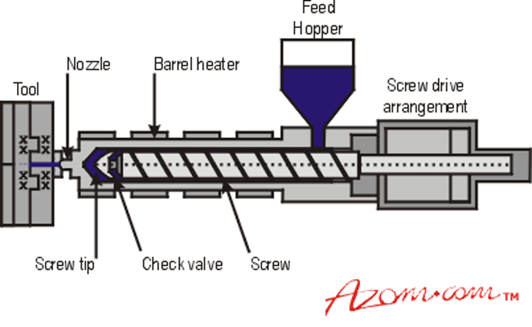
Plastic Injection Breakdown: Injection Unit
The Injection Unit's main objective is to heat the material to the specified temperature until it reaches a viscosity that will allow the material to flow into the mold while under force.
TUTAMEN 2021 Introduction To Plastic Molding

Slide 8
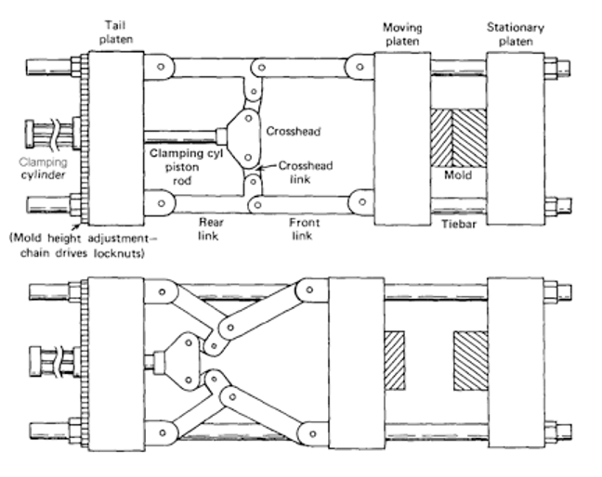
Plastic Injection Breakdown: Clamping Unit
The clamping unit’s main function is to open and close the mold along with ejecting the parts. The two most common types of mold clamps are the are the direct hydraulic and the toggle clamps. Toggle clamps are actuated by hydraulic cylinders. These clamps utilize mechanical linkages to generate higher forces than a direct connection from a hydraulic cylinder of the same size.
TUTAMEN 2021 Introduction To Plastic Molding

Slide 9
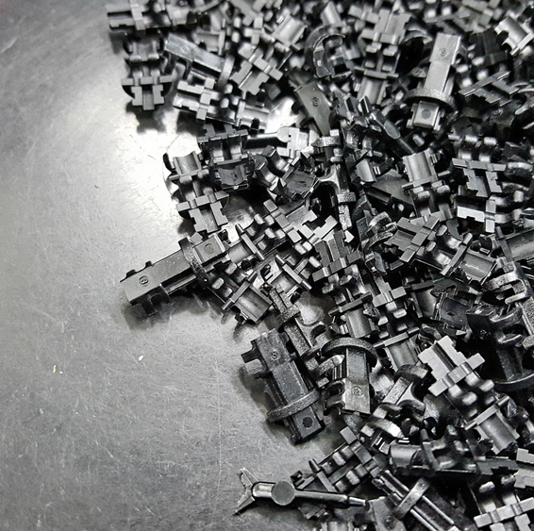
Specifications of Molding Machines
Molding Machines specifications have many characteristics yet there are only two most frequently used in specifying and describing the machine. The first is the shot size and the second is the clamping tonnage.
Shot Size
The shot size is the amount of material that can be injected into a cavity within one shot cycle. Due to the differences in material density, a standard for comparison was developed. Thus the accepted material for shot size comparison is polystyrene.
Clamp Tonnage
This is the maximum force that a machine can apply to a mold. One method is to categorize the machines based on this clamping force. A small machine will have less than 100 tons where a medium machine will be between 100 and 2000 tons. The very large machines will be up to and over 10,000 tons.
TUTAMEN 2021 Introduction To Plastic Molding

Slide 10
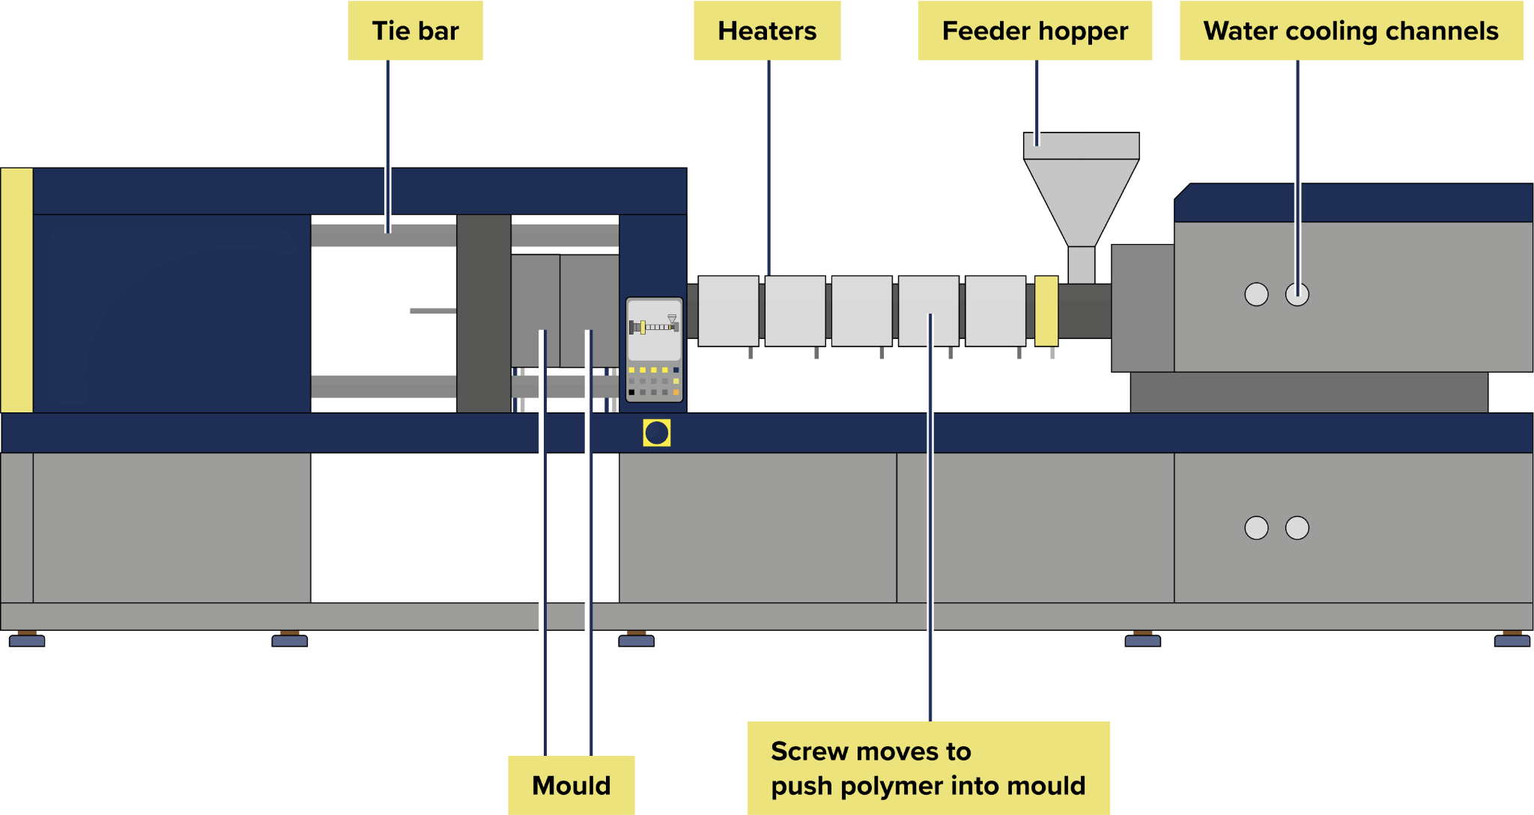
Molding
Process
TUTAMEN 2021 Introduction To Plastic Molding

Slide 11
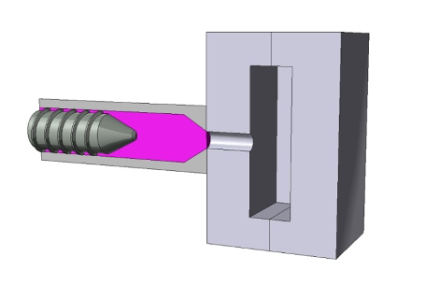
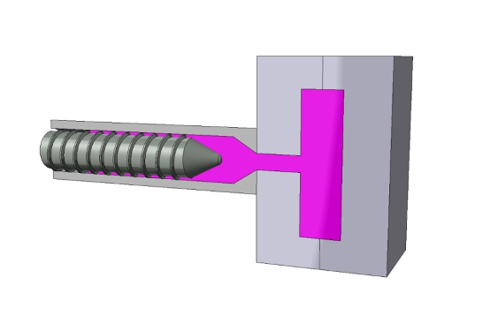
Plastic Injection molding process is the principal method for manufacturing plastic parts. Plastic is known to be a very resourceful and cost-effective material that is used in many applications. Although the tooling can be expensive, the cost per part ends up being very low.
The injection molding process involves taking plastic in the form of pellets or granules and heating these bits and pieces until a liquified state is obtained. This transition is known as plasticizing. If the melt temperature is too low the pressures will tend to rise and cause flashing or short shots in the part. If the temperature is too high you can encounter mechanical failure of the part due to material degradation. In the design process you must keep this in mind because if your part is not able to accept the melt without suffering other problems, you will have wasted time and money.
TUTAMEN 2021 Introduction To Plastic Molding

Slide 12
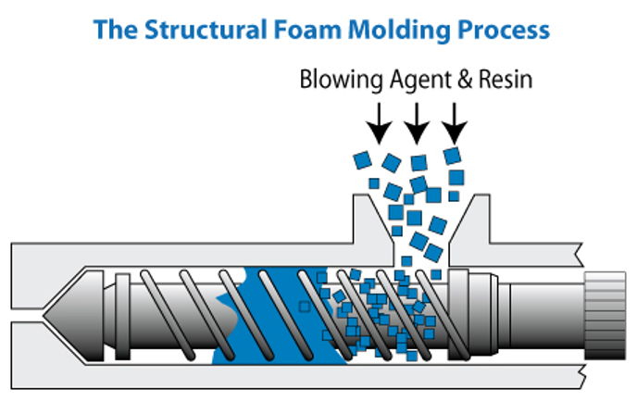
Molding Process
Once the material is liquified it is forced into a mold where it is allowed to "chill". If all goes well, you will have the part that you were trying to build. During this cooling phase, more pellets are loaded from the hopper into the barrel which heats these pellets to the melt state. The mold is then opened and the part is ejected. The mold is closed and the cycle begins again.
There are two types of injectors. The first is a simple ram that travels forward to inject the plastic and back to receive more pellets. This unit relies only on the heat of the barrel to melt the plastic. The second type of ram is a combination of the first with the addition of threads along the ram that serve two purposes. The first purpose is to draw plastic pellets into the barrel as the ram is reversed. The second is to aid in the melt process by adding mechanical fraction to the heat equation.
TUTAMEN 2021 Introduction To Plastic Molding

Slide 13
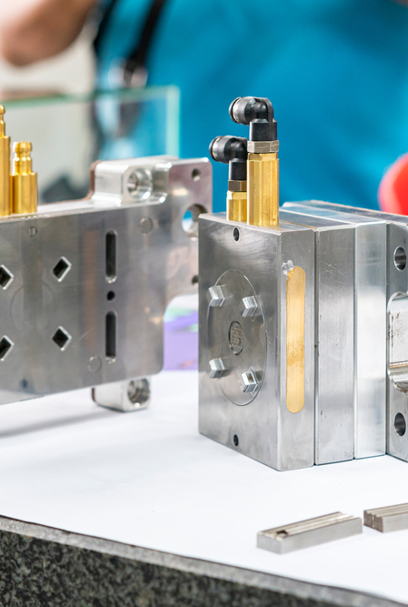
Problem Areas
Surface is not smooth: Melt temperature may be too high causing resin decomposition and gas evolution (bubbles). Excessive moisture in the resin. Low pressure causing incomplete filling of mold.
Burned Parts
Melt temperature may be too high. Polymer may be becoming trapped and degrading in the injection nozzle. Cycle time may be too long allowing the resin to overheat.
Injection
Injection stroke may be too small for mold (ie. not enough resin is being injected). Injection speed may be too slow causing freezing before mold is filled. Part disfigured: Uneven surface temperature of the molds. Non-uniform wall thickness of mold design.
Design
Part design should include draft features to facilitate removal from the mold. This can be evaluated in many of today's 3D CAD programs before starting the mold. Draft angles as low as one half a degree can be used in some situations. Typical draft angles should be about 1 to 2 degrees. Depending on the tolerance limit requirements most parts can be manufactured using Injection molding. The more complex the part the more complex the mold and the higher the cost.
TUTAMEN 2021 Introduction To Plastic Molding

Slide 14
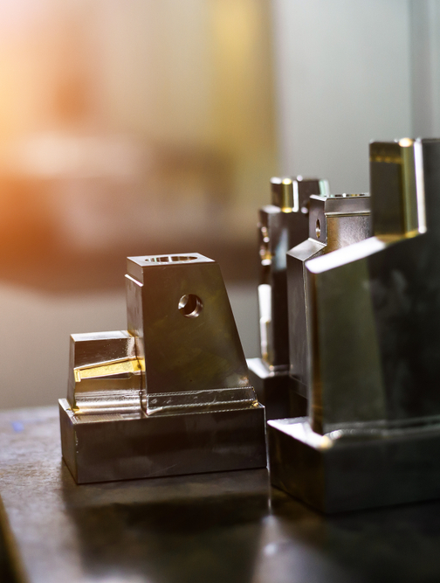
Wall Thickness
It is possible to build parts with very thin walls, as well as thick walls. When the two come together is when you run into problems. Plastic flows much differently in thick regions than thinner regions. Keeping the thickness uniform will help in the predictability of the part as well as lessen the cost of the mold. With uniform wall thicknesses you will lessen the chance of warpage due to uneven shrinkage. Remember that the thicker the wall the more mass and the more mass the more heat there is to dissipate.
Corners and Radiuses
A good rule to follow is to keep to a size that will maintain strength, but not so large that it will create problems. Also maintaining a uniform wall thickness at corners. If you have pins you should not have a larger diameter than the thickness of the wall it is extruded from. Cross walls should follow the same rule. The minimum radii should not be less than 1/4 minimum wall thickness. Design for radii to be 1/2 to 3/4 of the nominal wall thickness. When significant stress is present, design in larger radius as a larger radius distributes stress uniformly.
TUTAMEN 2021 Introduction To Plastic Molding

Slide 15
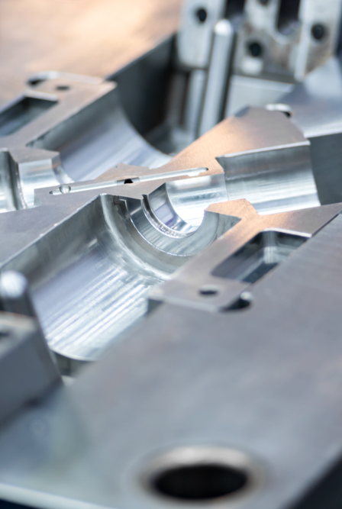
Ribs
Ribs should be 1/2 to 2/3 of the nominal wall thickness and less than 3 times thickness in height. Taper of 1 deg. is typical. Note: excess thickness promotes shrinkage. Excess rib height combined with taper will produce thin sections requiring extra fill time at the mold .
Bosses
Diameter = (Outside Diameter) \ (Inside Diameter) = 2 to 3
Thickness = 1/2 to 2/3 nominal wall thickness
Gusset Height = 2/3 Height
Height = Fastener minimum requirements
Taper = 1 deg. all around
Diameter Ratio should be minimum ratio of 2., this will reduce risk of failure.
Weld Lines
If you are able to use a flow simulation program on your part before making the mold you will be able to determine the location of your weld lines relatively easily. The location of these weld lines are determined by the melt front. When the plastic flows in opposite directions and eventually meets again this is where the weld lines develop. Weld lines are produced at the mating of the flow fronts of the plastic during molding. The weld line area is more susceptible to cracks and stress failure.
TUTAMEN 2021 Introduction To Plastic Molding

Slide 16
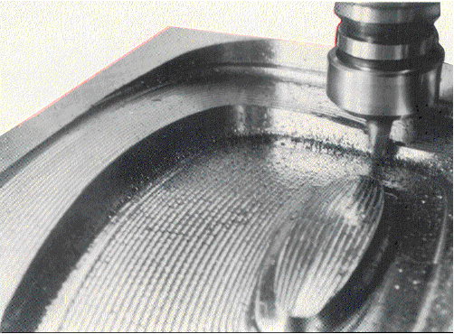
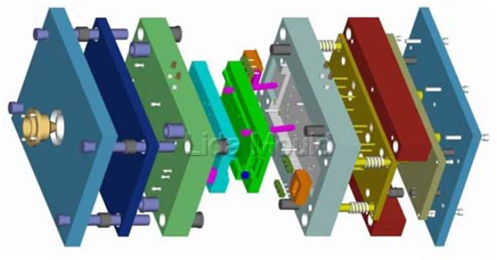
Mold Making and Mold Design
TUTAMEN 2021 Introduction To Plastic Molding

Slide 17
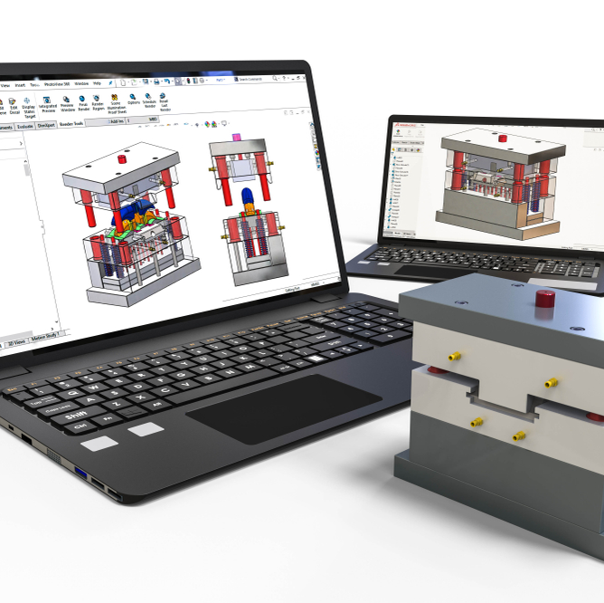
Mold Design
Designing and making molds for injection molding is more complicated than making extrusion die
Mold Parts – mold is placed in between stationary plate and the moveable plate
The connection from the injection unit to the mold is through the nozzle
The channel that runs through the stationary plate of the mold is called the sprue channel (material that is in the channel is called the sprue)
The solid sprue is removed from the finished part assembly after the part is ejected from the mold
Resin flow from the sprue through the runner (connecting channel) to the mold cavities
TUTAMEN 2021 Introduction To Plastic Molding

Slide 18
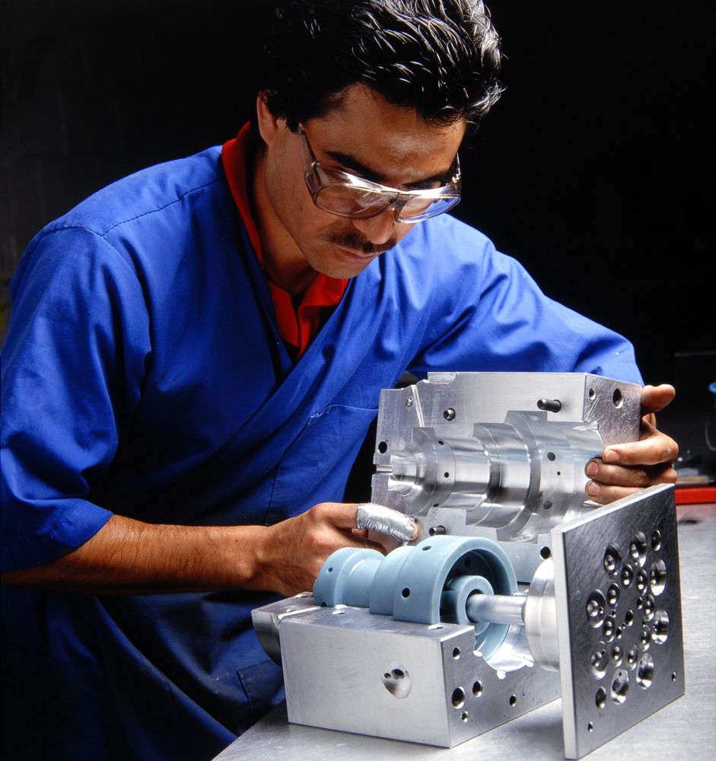
Assembly of various
mold parts
Mold bases can be purchased as entire units, then the cavities are cut from A & B plates
TUTAMEN 2021 Introduction To Plastic Molding

Slide 19
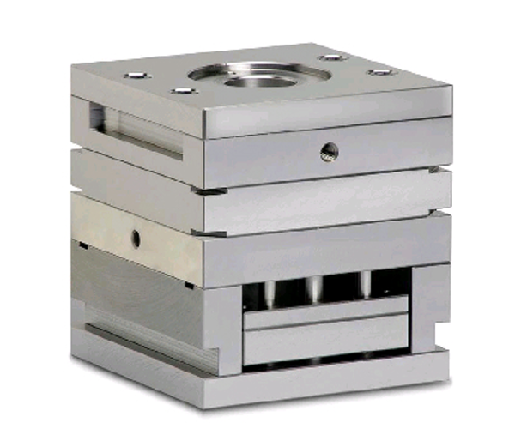
Mold Bases
Assembly of various mold parts
Mold bases can be purchased as entire units, then the cavities are cut from A & B plates
TUTAMEN 2021 Introduction To Plastic Molding

Slide 20
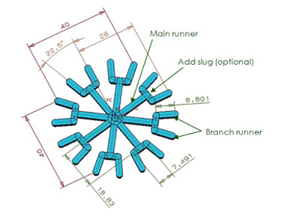
Mold Runners
Distribution system for the resin from the sprue to the cavities
Flow characteristics (viscosity), temperature and other factors are important in determining the runner diameter and length
If the diameter of the runner is too small or the length is too long the resin can freeze in the runner before the mold is completely full
If the runner system is too large, excess material would be ejected and too much regrind created
TUTAMEN 2021 Introduction To Plastic Molding

Slide 21
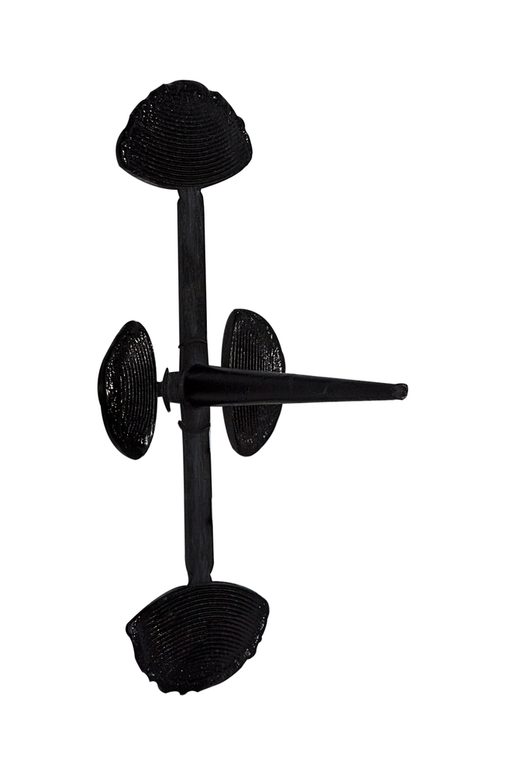
Mold Runners
If the resins have a high viscosity, larger runners are needed compared to low viscosity resin
The optimum flow of the resin through the runner system depends on the shape and diameter of the channel
Round channel gives the best flow characteristics, but it is difficult to machine
Machining cost can be reduced by machining one side of the mold plates
Better shape where the depth of the channel is at least two-thirds the size of the width and the sides are tapered between 2 to 5º.
TUTAMEN 2021 Introduction To Plastic Molding

Slide 22
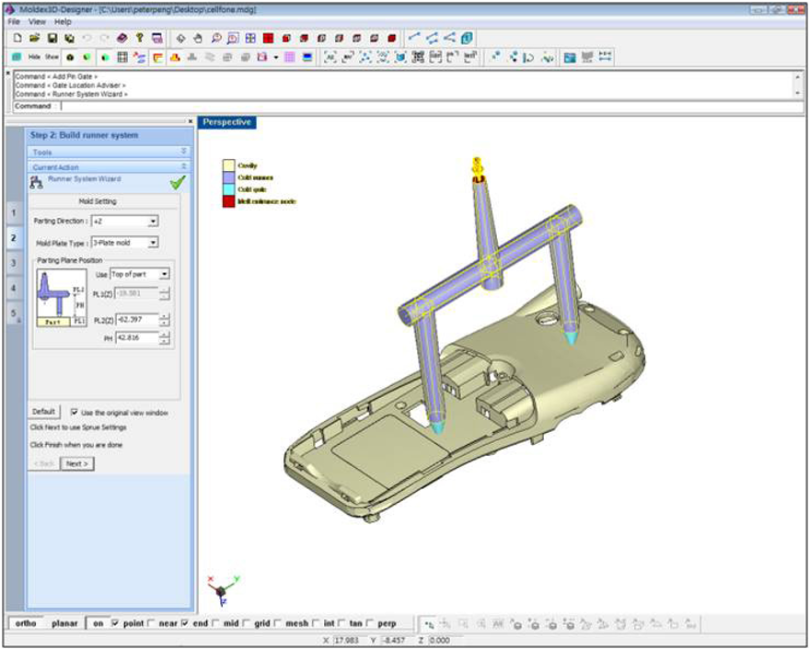
Mold Runners
TUTAMEN 2021 Introduction To Plastic Molding

Slide 23
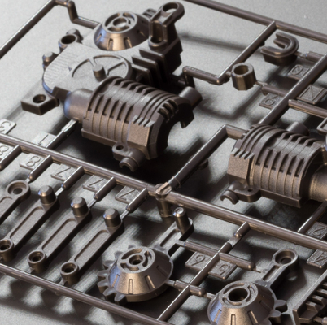
Mold Secondary Runners
Secondary runner channel are used for multi-cavity molds
The flow into the secondary channel should be streamlined (angle in flow direction)
The streamlined angle minimizes shear on the resin
TUTAMEN 2021 Introduction To Plastic Molding

Slide 24
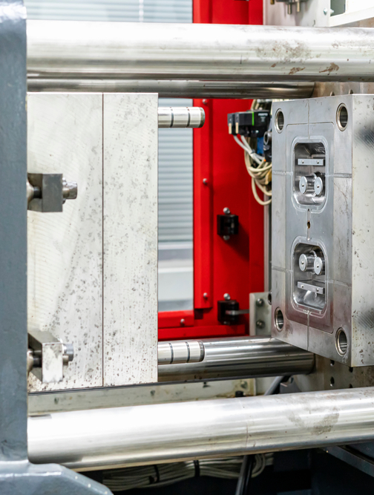
Mold Gate
The end of runner and the entry path
into the cavity
The gate shape can also affect the filling of the cavity, dimension and properties of the parts
Gate is the most restricted point in the injection molding system, i.e. for reinforcement and filler + polymer systems
Small rectangular opening at the end of the runner channel, connect to the edge of cavity
Edge gate can be below the parting line if the channel and part are also below the parting line
Or it can be symmetrically about the parting line, if the runner channel and part are at both side of parting line
TUTAMEN 2021 Introduction To Plastic Molding

Slide 25
Mold Submarine Gate
Starts from the edge of the runner, and goes into the cavity edge at an angle
It narrows to a point as it moves from the runner to the cavity
The advantage; separation of the parts and the runner is automatic
Disadvantage; gate cannot be used for some resins because of high shear
Mold Tab Gate
By connecting the runner directly into the cavity with no reduction in runner cross-section
Used for very large parts where a reduction in flow would disturb the resins flow pattern and might result inadequate flow into the cavity
TUTAMEN 2021 Introduction To Plastic Molding

Slide 26
Mold Fan Gate
Made by reducing the thickness and not the diameter of the runner channel as it goes into the cavity
Used for intermediate size, and when reinforcement in the resin cannot flow through the edge gate
Mold Ring Gate
Used to make hollow cylinder parts
The ring gate covers the entire top of the cylinder part so that the resin flow is downward into the wall of the part
TUTAMEN 2021 Introduction To Plastic Molding

Slide 27
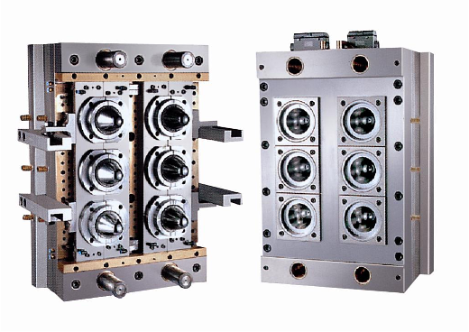
Mold Cavities
Are actual molding locations
Resin enter the cavities through gate, fills the cavities, and cools to form the solid. The parts are ejected and finished
Cavities are the heart of the molding process, and must be precisely prepared
The shape of the cavities determines the shape of the part
Example of a 6 cavity mold
TUTAMEN 2021 Introduction To Plastic Molding

Slide 28
Design Documents and Analysis For Parts and Molds - DFM
Design for Manufacturing (DFM) and design for assembly (DFA) are the integration of product design and process planning into one common activity. The goal is to design a product that is easily and economically manufactured.
The importance of designing for manufacturing is underlined by the fact that about 70% of manufacturing costs of a product (cost of materials, processing, and assembly) are determined by design decisions, with production decisions (such as process planning or machine tool selection) responsible for only
20%.
TUTAMEN 2021 Introduction To Plastic Molding

Slide 29
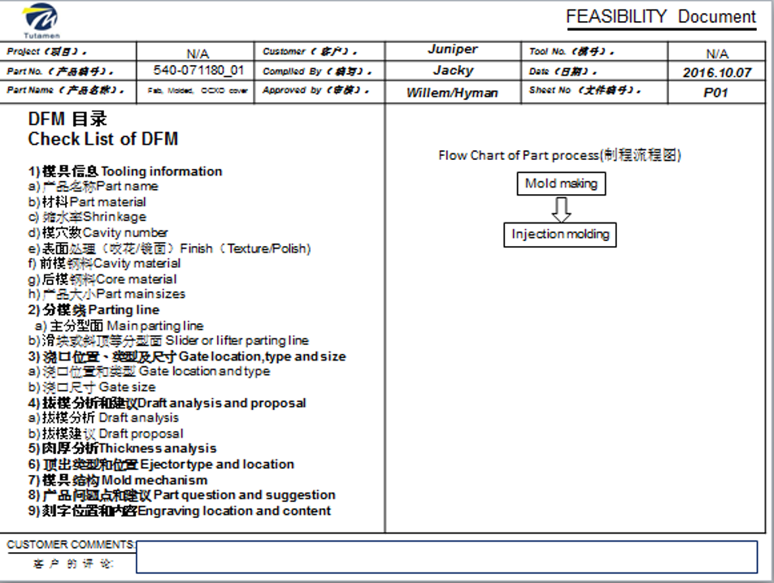
Tutamen DFM example
TUTAMEN 2021 Introduction To Plastic Molding

Slide 30
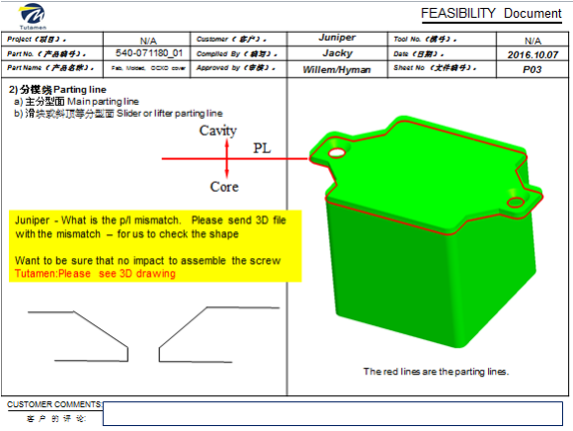
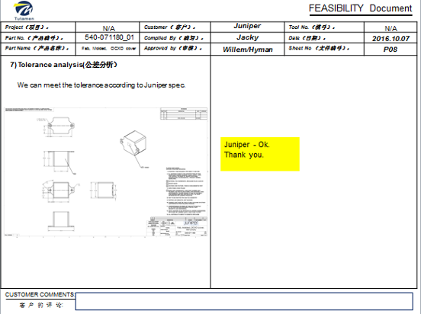
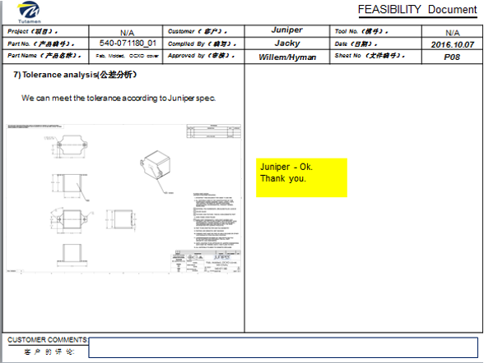
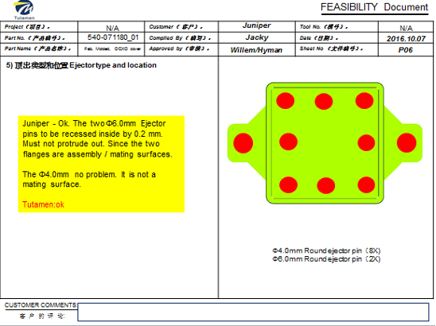

Slide 31
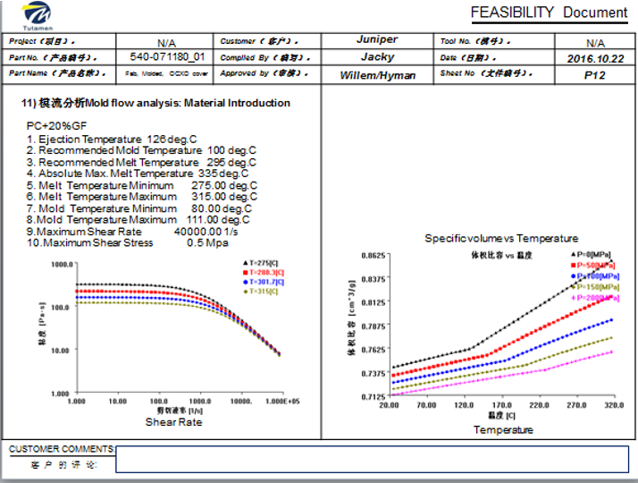
Design Documents and Analisis For Parts and Molds - Mold Flow
Engineers and analysts use mold flow plastics injection molding simulation software to improve plastic part designs, injection mold designs, and manufacturing processes.
TUTAMEN 2021 Introduction To Plastic Molding

Slide 32
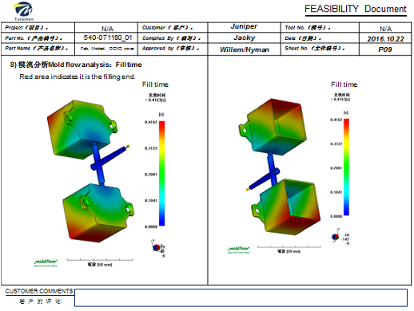
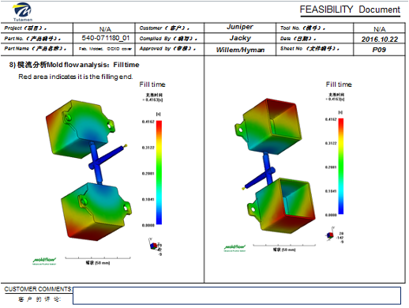
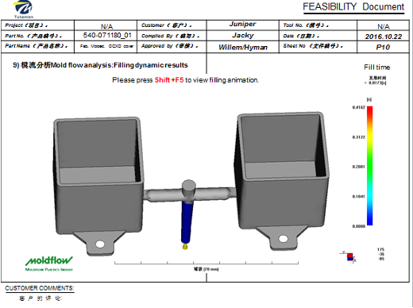
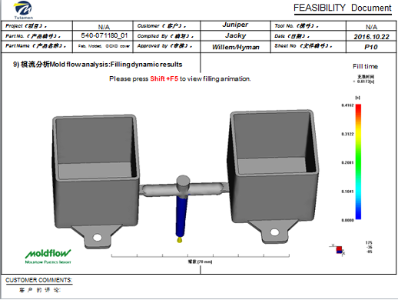
Example
TUTAMEN 2021 Introduction To Plastic Molding

Slide 33

Get in touch
tutamen@tutamen.net
THANK YOU!
TUTAMEN 2021 Corporate Overview

