Slide 1
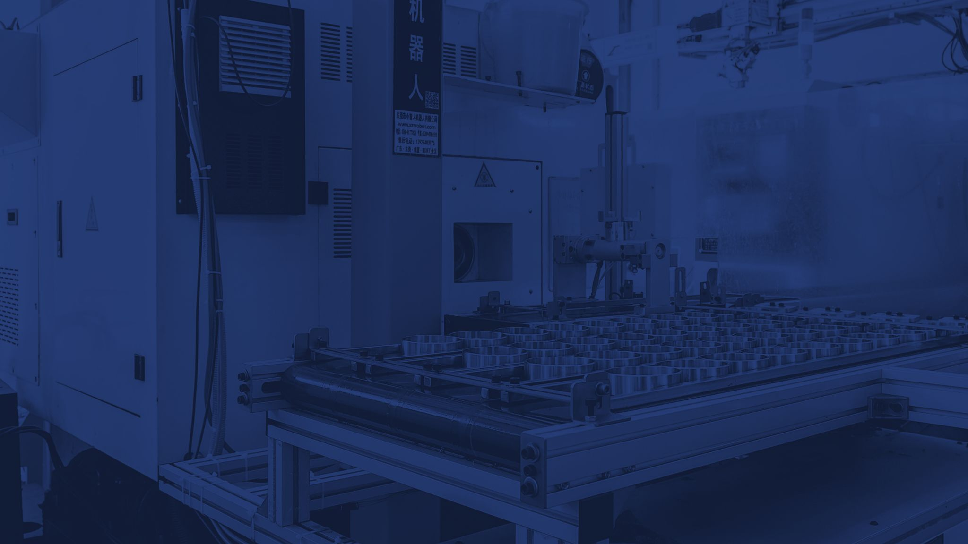
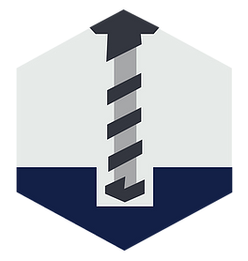
TUTAMEN
Metal Machining

Slide 2
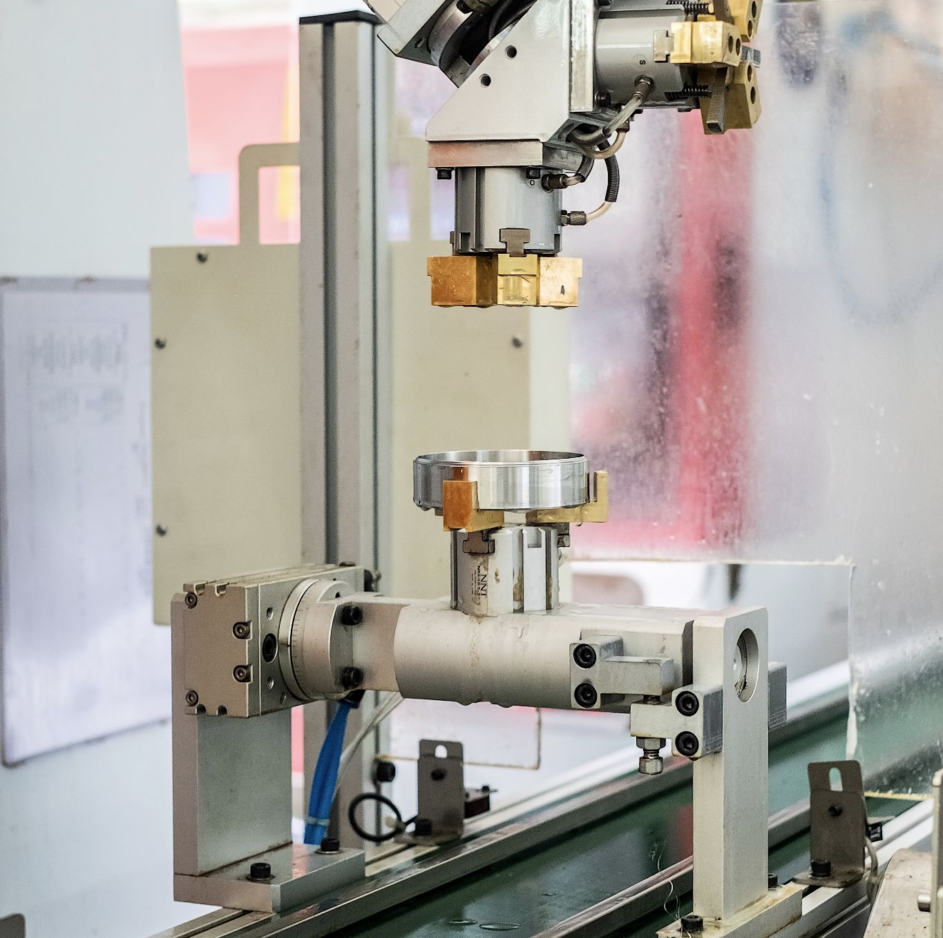
Intro To Metal Machining
Used to process metal to the desired shapes and sizes for simple and complex parts
2 different machining methods are used to manufacture parts: Lathe and Mill
In a Milling machine the part is held in place by a fixture, then a spinning blade is used to cut out the shape.
In a Lathe the part is spinning while a blade held in place is pushed against it to create circular cuts
TUTAMEN 2021 Corporate Overview

Slide 3
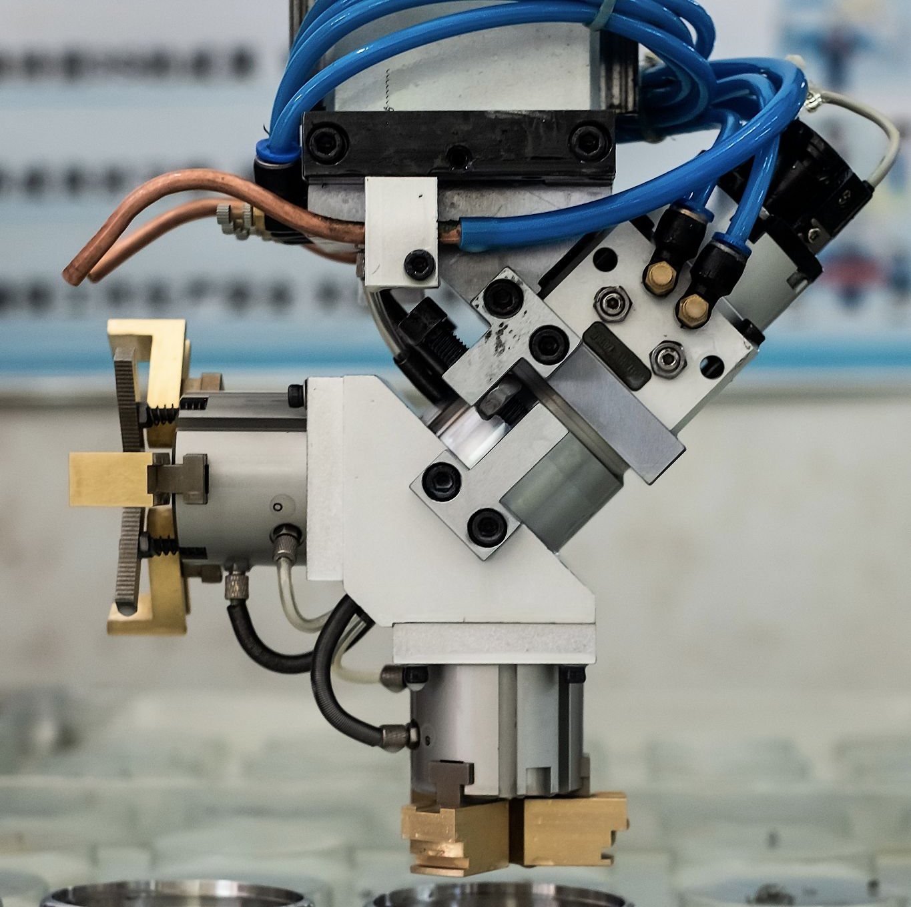
Intro To Metal Machining
Custom fixtures are used to hold the multiple parts at a time to improve processing time and tolerances
Lubricant is sprayed on the part while machining to improve blade life and prevent 'chipping' or too much heat
Use a wide variety of raw materials to minimize waste when
machining
TUTAMEN 2021 Corporate Overview

Slide 4
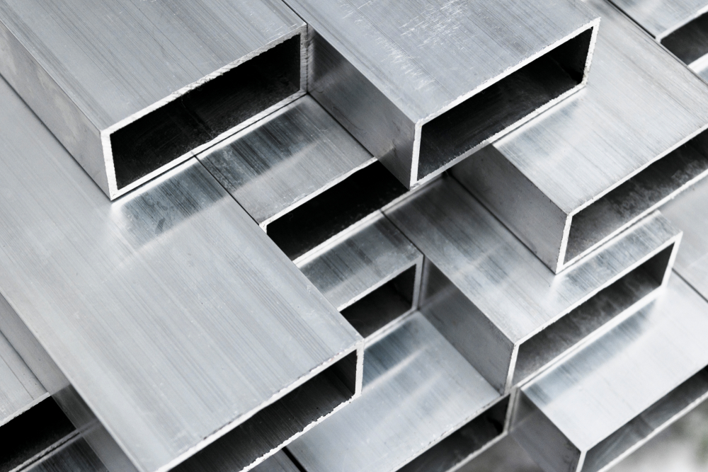
Most Common Materials and Their Uses:
Aluminum
Has a fairly low density and as such is "softer" which makes machining times quicker and blade wear lower. With its light weight and ability to resist corrosion, it is a popular material in the aerospace industry. It is also easy to create extrusions for raw material, meaning less wastage when processing.
Stainless steel
Stainless steels have poor machinability compared to regular carbon steel because they are tougher, gummier and tend to work harden very rapidly. Slightly hardening the steel may decrease its gumminess and make it easier to cut. AISI grades 303 and 416 are easier to machine because of the addition of sulphur and phosphorus.
Brass
From a machining perspective, brass is very similar to aluminium as it is relatively "soft" and easy to machine.
TUTAMEN 2021 Corporate Overview

Slide 5
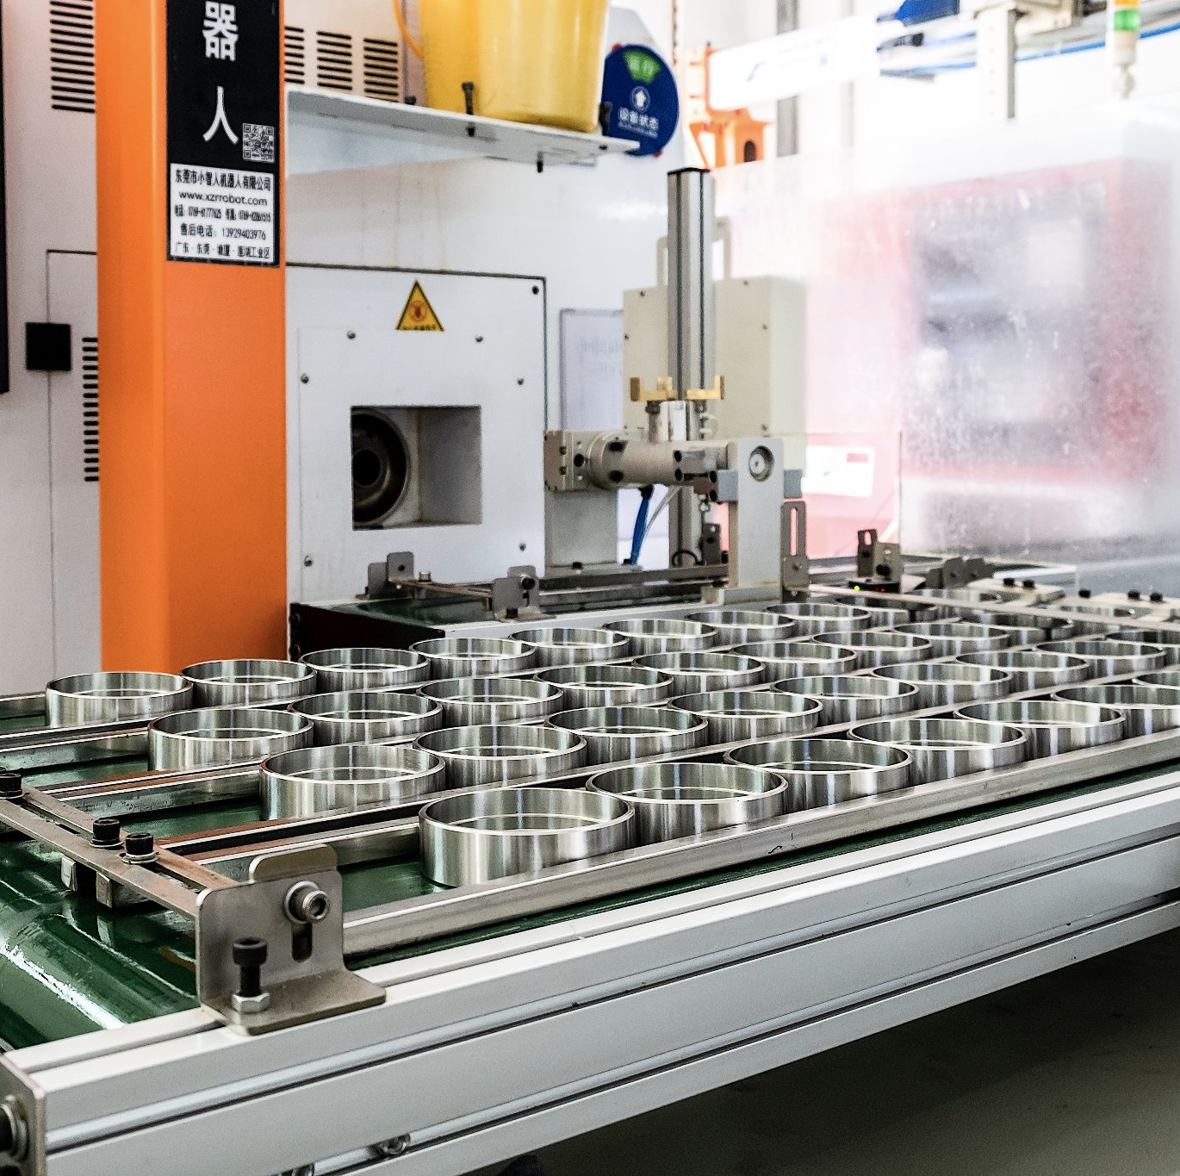
Lathe
The basic idea of a CNC lathe is that the material is held in a clamp then spins at a high RPM and static blades are introduced to make circular cuts of varying shapes and sizes depending on the cutter used. The turret holds the tool holders and indexes them as needed. The spindle holds the workpiece and there are slides that let the turret move in multiple axes simultaneously.
TUTAMEN 2021 Corporate Overview

Slide 6
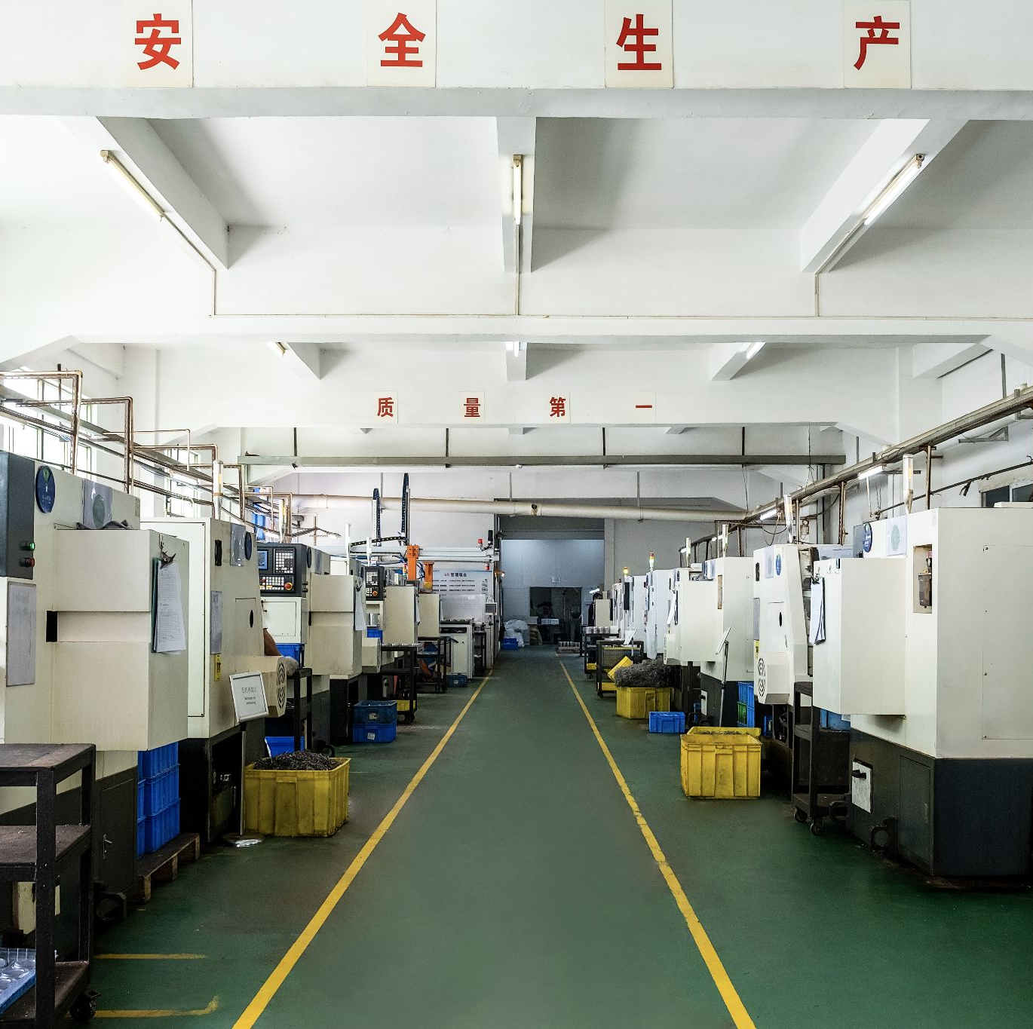
Swiss Turning
A Swiss-style lathe holds the workpiece with both a collet and a guide bushing. The collet sits behind the guide bushing and the tools sit in front of the guide bushing, holding stationary on the Z axis. To cut lengthwise along the part, the tools will move in and the material itself will move back and forth along the Z axis.
TUTAMEN 2021 Corporate Overview

Slide 7
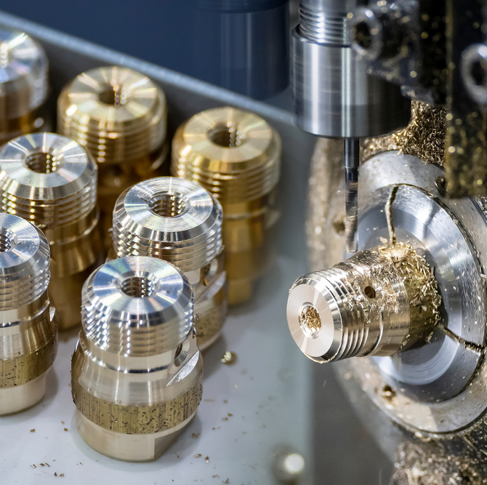
Swiss Turning
This allows all the work to be done on the material near the guide bushing where it is more rigid, making them ideal for working on slender workpieces as the part is held firmly with little chance of deflection or vibration occurring. This style of lathe is commonly used under CNC control. Swiss lathes are used to minimize different process and produce tight tolerance parts over a standard lathe.
TUTAMEN 2021 Corporate Overview

Slide 8
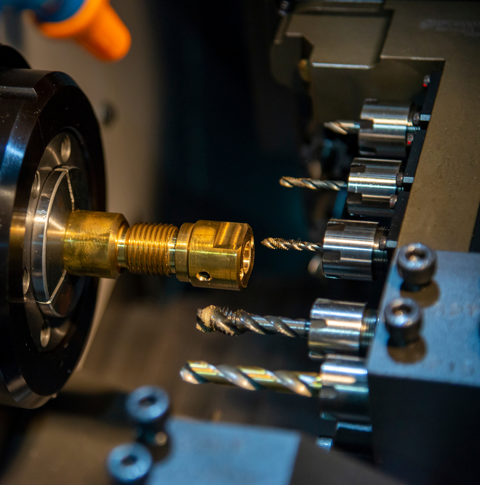
Milling
Milling is the machining process of using a rotary cutter to remove material from a workpiece by advancing (or feeding) the cutter into the workpiece in a certain direction. The cutter may also be held at an angle relative to the axis of the tool. Milling covers a wide variety of different operations and machines, on scales from small individual parts to large, heavy-duty gang milling operations.
TUTAMEN 2021 Corporate Overview

Slide 9
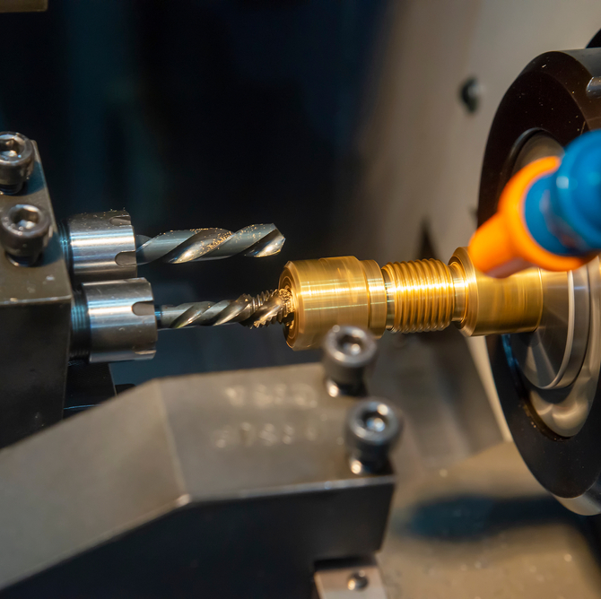
Milling
It is one of the most commonly used processes for machining custom parts to precise tolerances. In addition, we can add a 4th or 5th axis allowing us to machine the material from more angles while using the same fixture. The adding of other axes helps to minimize uneven surfaces and take human error out of the process — human error usually due to the part moving from one fixture to another in order to machine a different surface.
TUTAMEN 2021 Corporate Overview

Slide 10
Raw Materials
Block
For low volume parts we will purchase the raw material as a square or rectangular block big enough to cover the size of the finished product, and a bit extra so we can hold the material in a fixture.
Extrusion
Extrusion is a process used to create objects of a fixed cross-sectional profile. A material is pushed through a die of the desired cross-section. The two main advantages of this process over other manufacturing processes are its ability to create very complex cross-sections, and to work materials that are brittle, because the material only encounters compressive and shear stresses. It also forms parts with an excellent surface finish. Generally used for higher volume parts.
Die Casting
Die casting is a metal casting process that is characterized by forcing molten metal under high pressure into a mold cavity. The mold cavity is created using two hardened tool steel dies which have been machined into shape and work similarly to an injection mold during the process. However, the surface finish is generally more porous.
TUTAMEN 2021 Corporate Overview

Slide 11
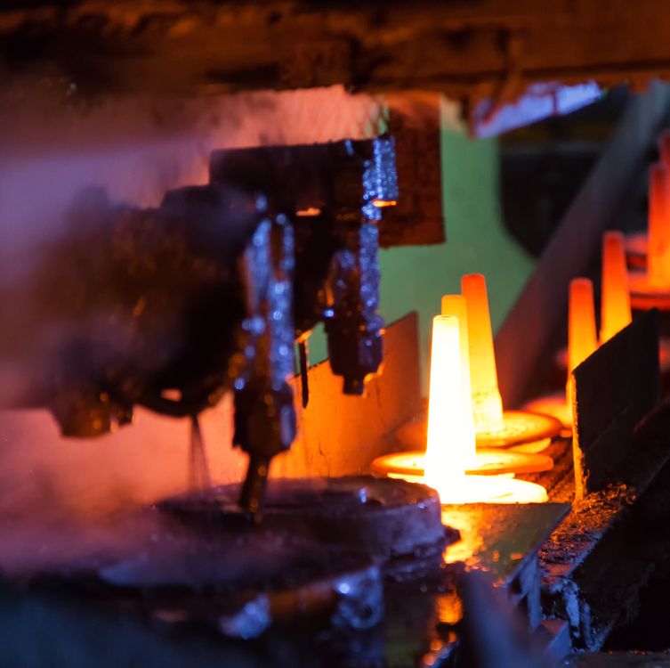
Fixtures
Fixtures are designed for repeatability, efficiency, and usefulness. To improve cycle times, multiple parts will be fitted to the fixtures and machined at the same time. This also means our machines can run for a longer period of time making them less labor intensive. They are designed to be rugged and last long while holding tolerances and avoiding damaging the parts.
TUTAMEN 2021 Corporate Overview

Slide 12
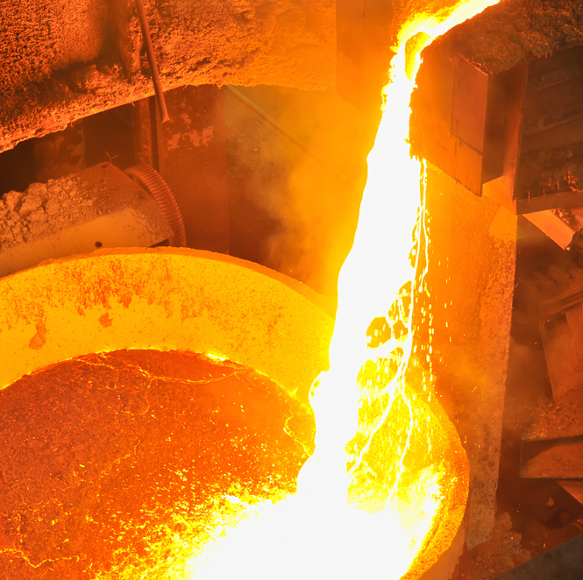
Tool path
There are essentially 2 stages to creating a tool path.
A Rough Cut and Fine Machining:
The Rough Cut is used to cut our raw material using a big blade to bulk cut material at a fast speed and get the part as close to the finished piece as possible. This allows longer blade life and faster machine time.
The Fine Machining stage is going into the part using smaller, or custom blades to shape the part into the final unit and meet tight tolerances. Generally fine machining is a slower process as the blades will be thin and break easily.
TUTAMEN 2021 Corporate Overview

Slide 13
Problem Areas
Under Cuts
When a part has many undercuts in non- visible areas it creates potential for error and is harder to control. To get around the issue we use a T-blade and can program around the undercut, but it creates a higher potential for failure.
Thin Walls
Be aware of walls becoming too thin. If a hole is too close to the edge the vibrations will create increased failures in the hole itself or the wall will crack. Additionally, when the walls are too thin there is increased risk of deformation.
No Radius/ Unnecessary Radius
When milling into parts it is important to note the direction the cutter is coming from and define the radius. If the blade is parallel to the cut we must have a radius as the blade is spinning in a circular motion. When designing a part the bigger the radius the easier it is for machinability. If the blade is coming perpendicular to the part it is better to have a 90 degree angle, however we are able to put a radius in using a ball cutter, but it is a slower process than just a 90 degree angle. Of course this is dependent on design factors and strength criteria, but as a general guideline this helps to improve processing.
TUTAMEN 2021 Corporate Overview

Slide 14
Problem Areas
Deep Cuts
The deeper and narrower a hole is the higher the risk. As the blade pushes deeper into the part it will vibrate which will cause chipping, uneven surfaces, and blade breakage. We are able to work around these issues by slowing down processing time, however the deeper the cuts the higher the chance of failures.
Different Hole Sizes
Wherever possible it helps to keep hole and thread sizes consistent. When there are different hole and thread sizes on a part we must take more time to change blades and use different gauges to inspect, slowing down production time and sometimes adding another process.
Mismatched Surfaces
A potential issue when coming at a part from different sides is mismatched surfaces. Basically it is impossible to perfectly match cuts on the same surface when they are cut at different stages, therefore wherever possible we machine every surface fully one time to avoid the mismatch.
TUTAMEN 2021 Corporate Overview

Slide 15
Problem Areas
Assembly Tolerances
It is important to be aware of stacking tolerances when using different machined parts going into sub and then final assemblies. Often we will see components with loose tolerances being assembled into a final part with the same tolerance, but due to stacking it will go out of spec.
Unnecessarily Tight Tolerances
It goes without saying that the tighter the tolerance the more difficult it is to produce, wherever possible it greatly helps manufacturability to loosen tolerances. This will decrease cost and improve yield.
TUTAMEN 2021 Corporate Overview

Slide 16
Get in touch
tutamen@tutamen.net
THANK YOU!
TUTAMEN 2021 Corporate Overview

