Slide 1
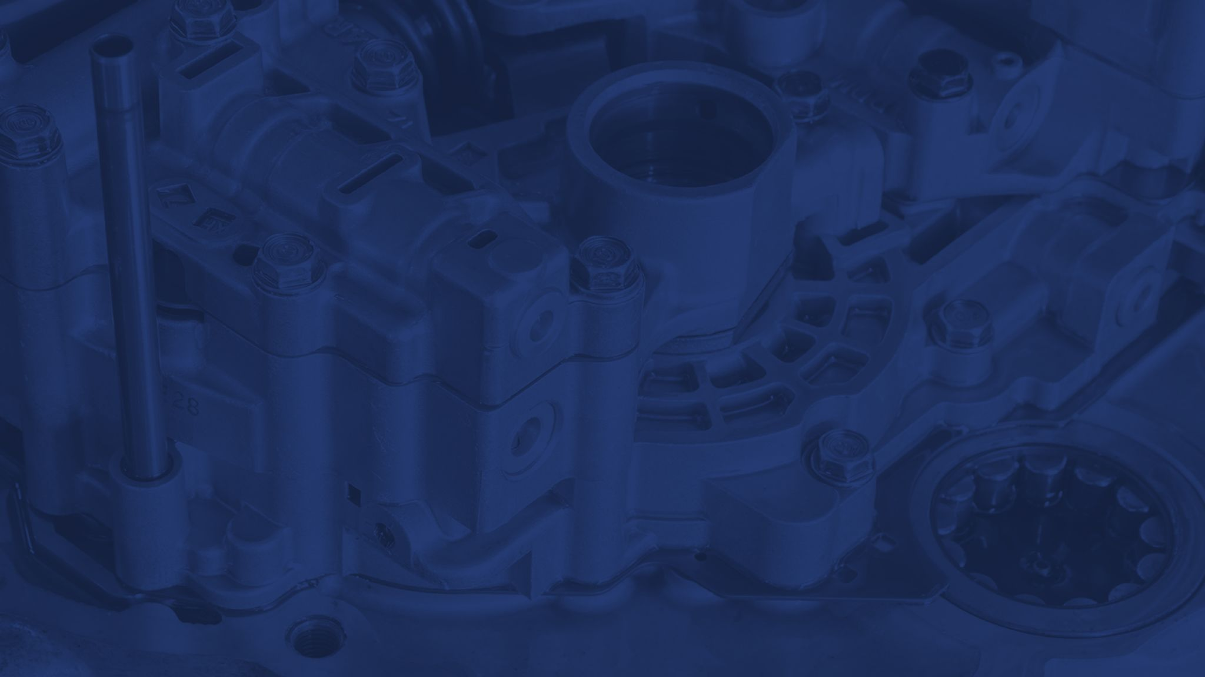
TUTAMEN
Die Casting Capabilities

Slide 2
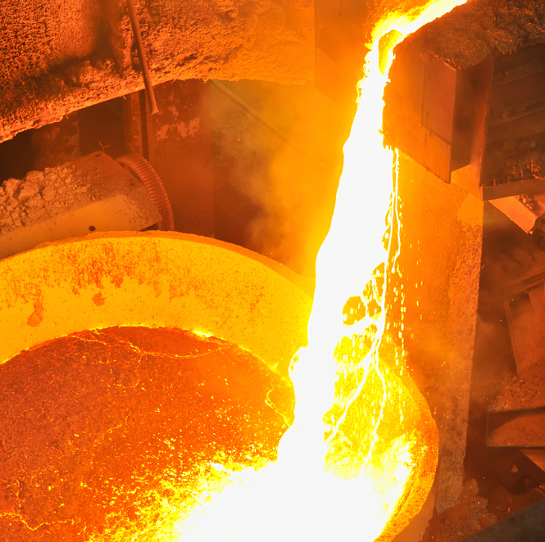
In 2019 we established our Die casting facility. With the ability to design and build molds in house, an automated line, and our large machine shop connected we are able to be competitive and effective at high volume complex parts
TUTAMEN 2021 Corporate Overview

Slide 3
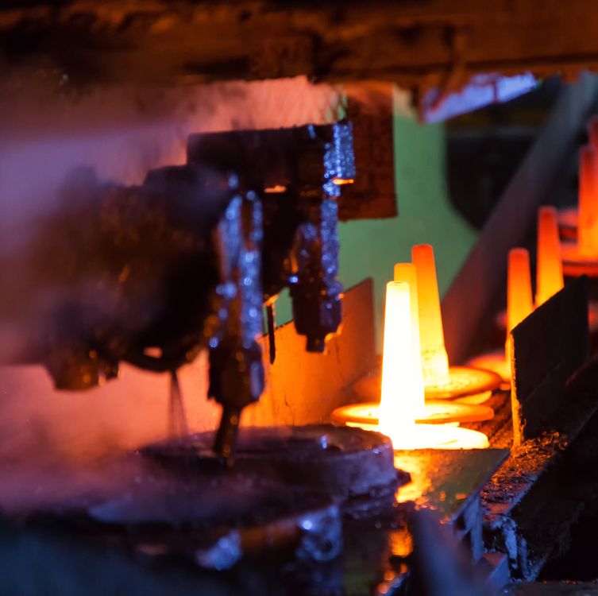
Machines
400 ton with automatic lines
2 x 300 ton with automatic lines
Additional 400 ton with automatic lines set for delivery mid 2021
TUTAMEN 2021 Corporate Overview

Slide 4
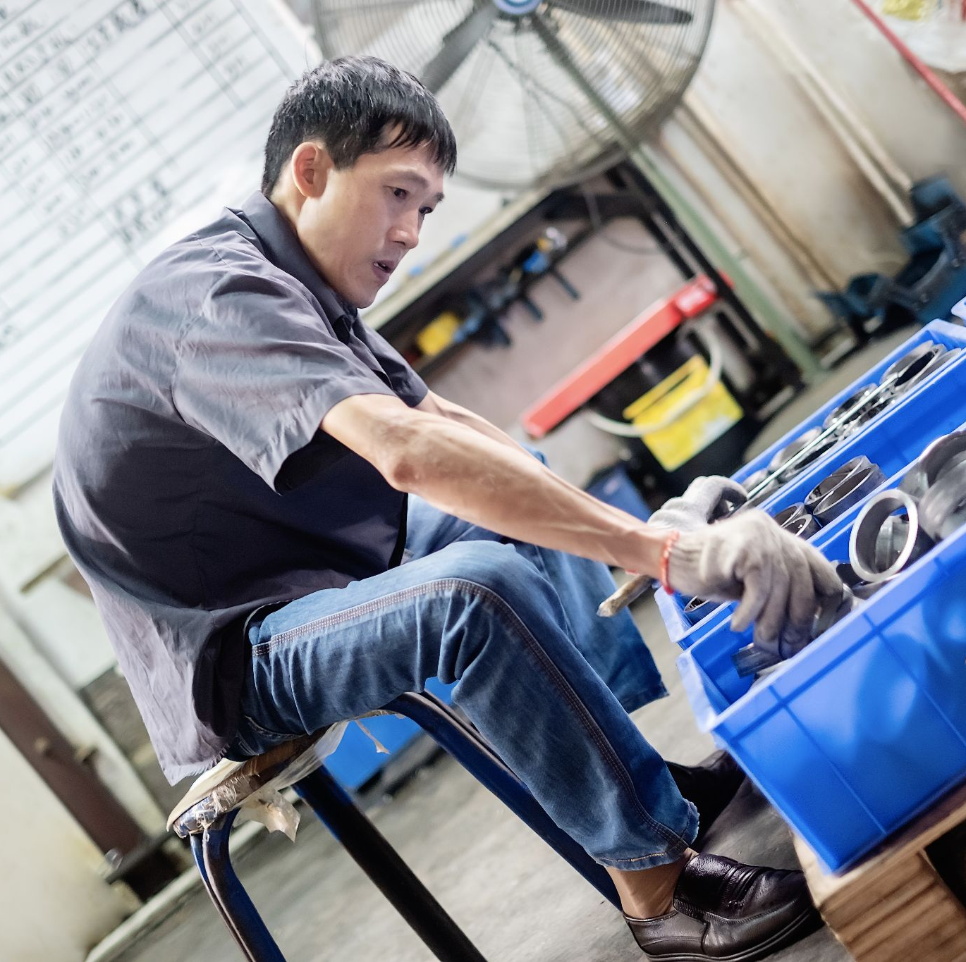
Tooling
Tooling design engineers and an expert team of tooling "Shifus" (Masters)
Large tooling shop connected to the machining area for quick turnaround on new tools and modification
Create extra key components for all molds to limit downtime in the event of wear or breakage
TUTAMEN 2021 Corporate Overview

Slide 5
Get in touch
tutamen@tutamen.net
THANK YOU!
TUTAMEN 2021 Corporate Overview

